Slide 1

SQL
PORTFOLIO
PROJECT
BY RANIT GHATAK

Slide 2
Overview
In this project I have analyzed the data of a food delivery company. There are total 4 Tables involved. The Tables have columns in common. Using those common columns I have joined them and tried to extract meaningful results.
I have tried to find out the spending pattern of the Customers.
What changes have happened in the Customer Behaveour after buying the Gold Subscription.
Reward based Analysis

Slide 3
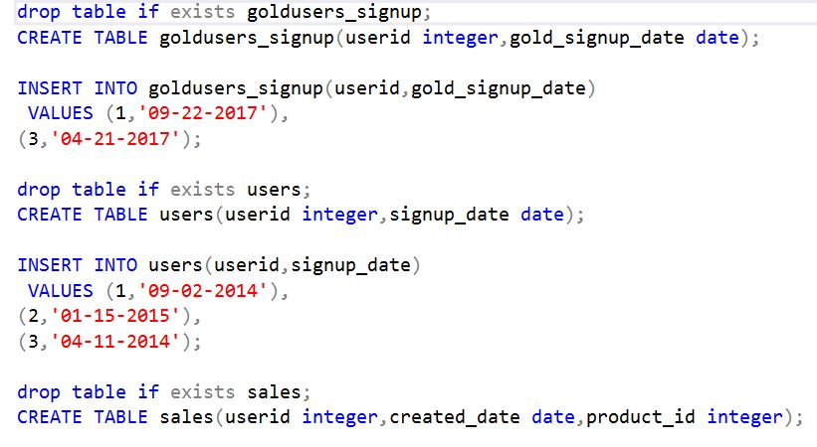
DDL COMMANDS

Slide 4
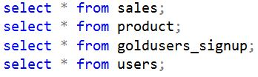
Details Of Tables

Slide 5
The total amount spent by each customer

Slide 6
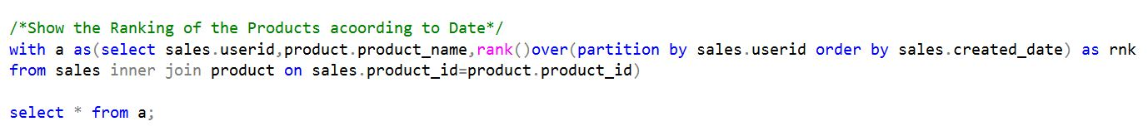
The Ranking of the Products according to Date

Slide 7
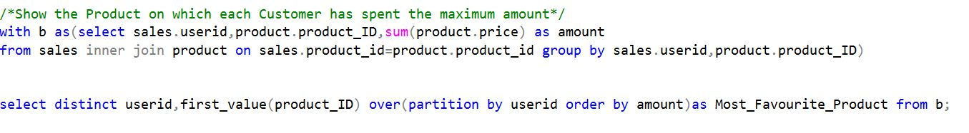
The Product on which each Customer has spent the Max Amount

Slide 8
The Products which the Customers Have bought just after buying the Gold Subscription

Slide 9
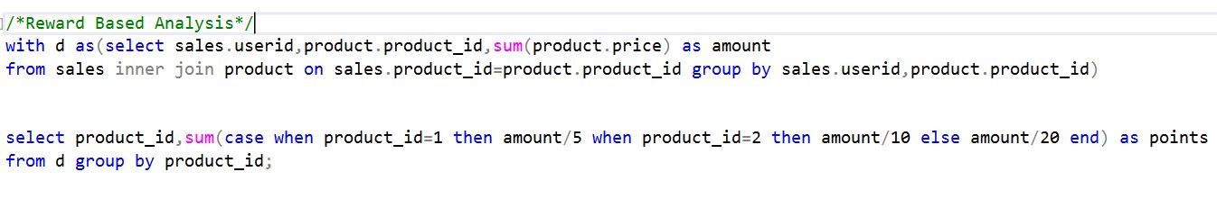
Reward Based Analysis

Slide 10
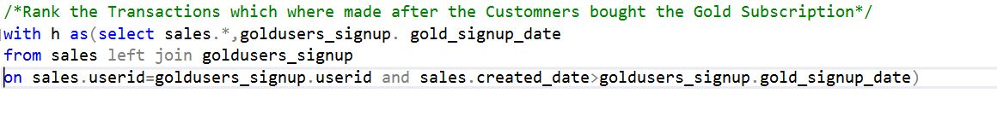
Rank the Transactions which were made after the Customers bought the Gold Subscription

Slide 11
Thank You

